Slide 1
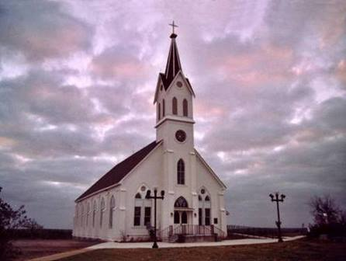

Slide 2
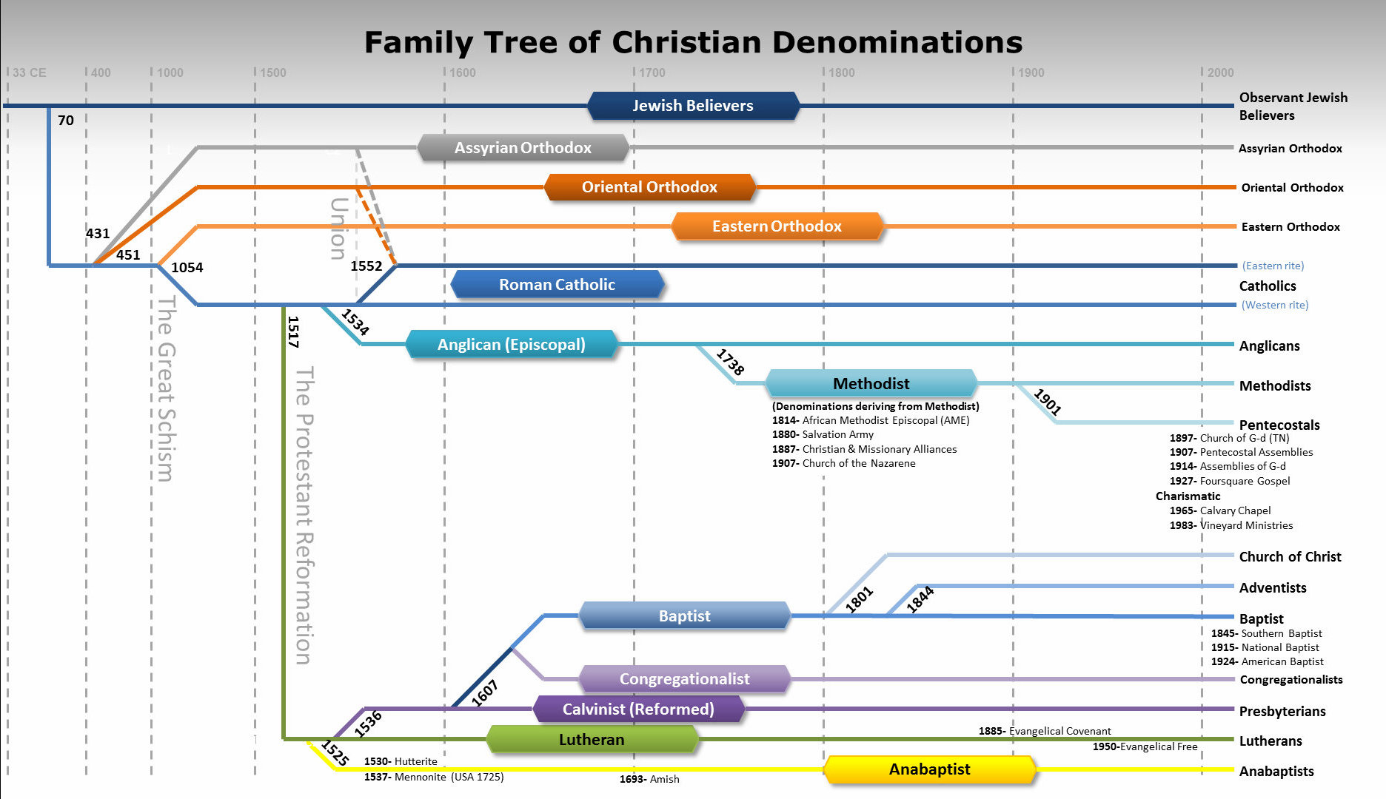

Slide 3
Ephesians 4
4 I therefore, a prisoner for the Lord, urge you to walk in a manner worthy of the calling to which you have been called, ² with all humility and gentleness, with patience, bearing with one another in love, ³ eager to maintain the unity of the Spirit in the bond of peace. ⁴ There is one body and one Spirit—just as you were called to the one hope that belongs to your call— ⁵ one Lord, one faith, one baptism, ⁶ one God and Father of all, who is over all and through all and in all.

Slide 4
⁷ But grace was given to each one of us according to the measure of Christ's gift. ⁸ Therefore it says, “When he ascended on high he led a host of captives, and he gave gifts to men.”

Slide 5
¹¹ And he gave the apostles, the prophets, the evangelists, the shepherds and teachers,

Slide 6
Apostles
Prophets
Evangelists
Teachers
Shepherds

Slide 7
¹¹ And he gave the apostles, the prophets, the evangelists, the shepherds and teachers, ¹² to equip the saints for the work of ministry, for building up the body of Christ,

Slide 8
Ap
Ev
Teacher
Pr
Sh

Slide 9
Ap
Ev
Teacher
Pr
Sh

Slide 10
Ap
Ev
Teacher
Pr
Sh

Slide 11
Ap
Ev
Teacher
Pr
Sh

Slide 12
¹¹ And he gave the apostles, the prophets, the evangelists, the shepherds and teachers, ¹² to equip the saints for the work of ministry, for building up the body of Christ, ¹³ until we all attain to the unity of the faith and of the knowledge of the Son of God, to mature manhood, to the measure of the stature of the fullness of Christ, ¹⁴ so that we may no longer be children, tossed to and fro by the waves and carried about by every wind of doctrine, by human cunning, by craftiness in deceitful schemes.

Slide 13
¹⁵ Rather, speaking the truth in love, we are to grow up in every way into him who is the head, into Christ, ¹⁶ from whom the whole body, joined and held together by every joint with which it is equipped, when each part is working properly, makes the body grow so that it builds itself up in love.

Slide 14
Apostles
Prophets
Evangelists
Teachers
Shepherds

Slide 15
Pioneers
Developers

Slide 16
Pioneers
Developers
Apostles, Prophets, Evangelists
Shepherds, Teachers

Slide 17
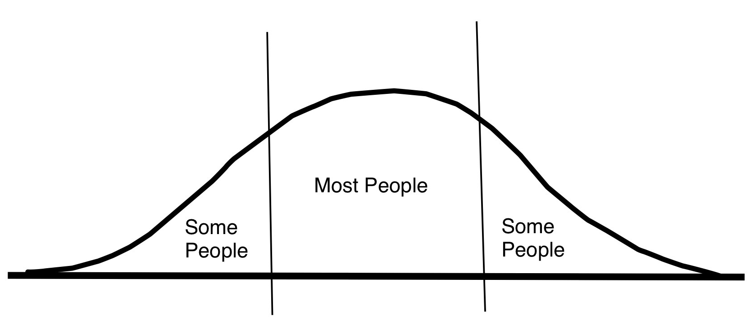
Pioneers
Developers

Slide 18
To Be the Body of Christ,
We Must Work Together

Slide 19
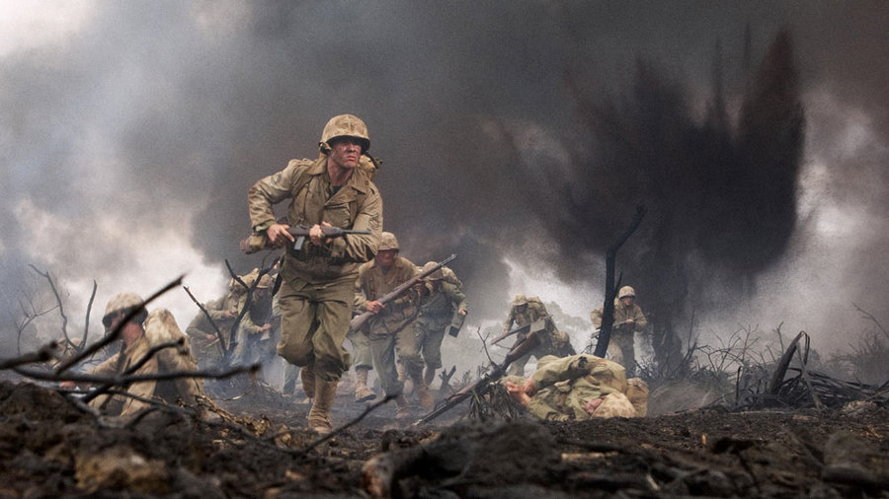

Slide 20
To Be the Body of Christ,
We Must Work Together

